Slide 1
Aggregation

Slide 2
Aggregation
Aggregation follows the Has-A model where one class owns the object of another.

Slide 3
Independent lifetimes
In aggregation, the lifetime of the owned object does not depend on the lifetime of the owner.
If the owner object gets deleted, the owned object can continue in the program.

Slide 4
Aggregation
In aggregation, the parent only contains a reference to the child, which removes the child’s dependency.

Slide 5
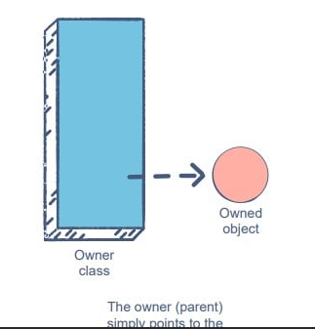
Aggregation
You can probably guess from the illustration that we’ll need object references to implement aggregation

Slide 6
Aggregation
Aggregation is a concept in which an object of one class can own or access another independent object of another class.
It represents Has-A’s relationship.
It is a weak relationship. Both the entities can survive individually which means ending one entity will not affect the other entity.

Slide 7
Aggregation
Aggregation is a form of composition where objects are loosely coupled. There are not any objects or classes owns another object. It just creates a reference. It means if you destroy the container, the content still exists.

Slide 8
Aggregation Examples
Library has students
Car has passengers
Vehicle has driver
Department has staff

Slide 9
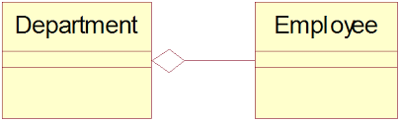
Aggregation in UML

Slide 10
Class Activity
Give examples for Aggregation in daily life.

Slide 11
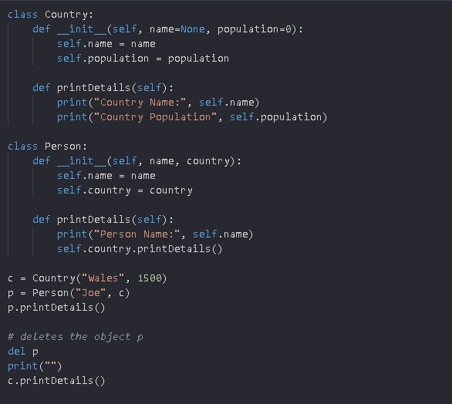
Aggregation in Python

Slide 12
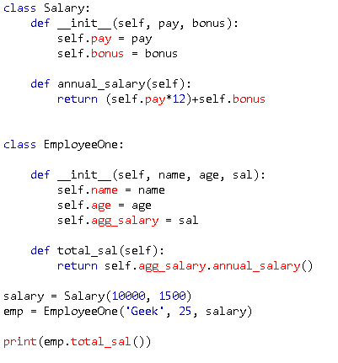
Aggregation in Python

Slide 13
Class Task
Create a Room class having a fan, a clock and a chair.

